Slide 1

York Breathing Timer
For EMST 150 Trainer Device

Slide 2

Introduction

Slide 3

states & steps supported by app
Ready – when you open the app
Active
1 second countdown for each inhalation.
1 second countdown for each exhalation.
13/28* second pause after exhalations 1-4 in each 5-breath set.
60 second pause after exhalation 5 in each 5-breath set.
Steps 1-4 are repeated 5 times to complete the session.
Completed – after five 5-breath trials are completed
Paused/Reset
*Length of pauses is configurable between 15 and 30 seconds.

Slide 4

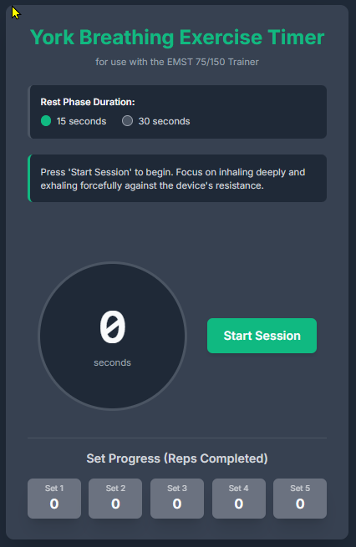
Current Components
Title
Sub-Title
Rest Phase Duration time selector
Message Box
Dynamic Status Text Label Area
Control Buttons (desktop)
Timer Display
Set Progress Tracker Display Boxes

Slide 5
ready

Slide 6

Ready to start
York Timer – for EMST 150 Trainer Device
Press the “Start Session” button when you are ready to start the exercises.
Instruction box
Press Start button
Timer window
0 until Start Session button is pressed
Control buttons
Button 1: Start Session
Button 2: hidden
Progress Tracking
Boxes are all gray.
White zeros show in each box
0
Start Session
# of Reps Completed per Trial
0
0
0
0
0
5-Breath Trials Completed

Slide 7
Activity
Breathing Exercises and Pauses

Slide 8
Inhale cycle
Reset
York Timer – for EMST 150 Trainer Device
Inhale deeply and hold it until told to exhale (4 seconds).
Instruction box
Inhale instructions
Timer window
Counts down from 4-1 after Start Session button is pressed
Control buttons
Button 1: Pause Session
Button 2: Reset Session – returns to “Ready to Start” state.
Progress Tracking
Boxes are still gray.
White zeros show in each box
4
Pause Session
Reset Session
# of Reps Completed per Trial
0
0
0
0
0
5-Breath Trials Completed

Slide 9
Exhale cycle
Reset
York Timer – for EMST 150 Trainer Device
Exhale forcefully and fast using chest and stomach muscles – PUSH (4 seconds).
Instruction box
Exhale instructions
Timer window
Counts down from 4-1 after inhale counter reaches 1
Control buttons
Button 1: Pause Session
Button 2: Restart Session
Progress Tracking
Boxes are still gray.
White zeros show in each box
4
Pause Session
Reset Session
# of Reps Completed per Trial
0
0
0
0
0
5-Breath Trials Completed

Slide 10
Rest cycle (15 seconds)
Reset
York Timer – for EMST 150 Trainer Device
Rest and recover for 15 seconds.
Instruction box
Rest instructions
Timer window
Counts down from 15-1 after exhale counter reaches 1
Control buttons
Button 1: Pause Session
Button 2: Reset Session
Progress Tracking
Current trial box turns black.
Count is incremented in black box.
15
Pause Session
Reset Session
# of Reps Completed per Trial
1
0
0
0
0
5-Breath Trials Completed

Slide 11
Rest cycle (60 seconds)
Reset
York Timer – for EMST 150 Trainer Device
Rest and recover for 60 seconds before starting the next 5-breath trial.
Instruction box
Rest instructions for longer rest.
Timer window
Counts down from 60-1 after exhale counter reaches 1 for every 5th breath.
Control buttons
Button 1: Pause Session
Button 2: Reset Session
Progress Tracking
Current trial box turns green.
Count is incremented in green box.
60
Pause Session
Reset Session
# of Reps Completed per Trial
5
0
0
0
0
5-Breath Trials Completed

Slide 12
Completed & Paused
Final State & Options

Slide 13
Completed
Reset
York Timer – for EMST 150 Trainer Device
Great job completing your breathing exercises.
Instruction box
Rest instructions for longer rest.
Timer window
Set to 0 when the exhale of the last rep of the 5th trial is completed.
Control buttons
Button 1: EXIT closes the app.
Button 2: Reset Session
Progress Tracking
All trial boxes are green.
All counts are 5.
0
EXIT
Reset Session
# of Reps Completed per Trial
5
5
5
5
5
5-Breath Trials Completed

Slide 14
Paused
Reset
York Timer – for EMST 150 Trainer Device
Press “Resume Session” when you are ready to continue your exercises.
Instruction box
Resume instructions.
Timer window
Counter stops where it is when app is Paused and turns red.
Control buttons
Button 1: Resume Session
Button 2: Reset Session
Progress Tracking
Trial boxes and breath counts stay as they were when the exercise is paused.
9
Resume Session
Reset Session
# of Reps Completed per Trial
5
5
3
0
0
5-Breath Trials Completed

Slide 15
Add a Slide Title - 3

Slide 16
Add a Slide Title - 2

